Slide 1

Statistical Risk Management
Project-based Internship | Autumn 2023

Slide 2

Outline
01
Motivation
02
Preliminary Problems
03
Scientific Methods and Data
04
Expected Output

Slide 3
Motivation
The Contracting Division at ELCON is a large part of the business model and plays key role in the overall strategy.
At ELCON, contracting involves all the electrical work in building under construction, often involving fire systems, HVAC, and more.
ELCON is among the few electrical contractors in Denmark who have the capacity to work on large projects spanning over several years.
In 2022, Contracting accounted for 25% of total revenue and had a 43% total effect on EBIT.
Contracting is ripe with risk and the margin for error is small.
Contracting has great influence on ELCON’s overall finances.
Currently, there is no formal statistical model in place to evaluate these risks, and all risk assessments, provisions, and impairments are based on a subjective assessment backed by fundamental calculations.
A model based on a sound statistical foundation can turn hard facts into clear stories, and support the management at ELCON.

Slide 4
Preliminary Problems
A
B
C
D
Develop Time Series Model with Actuals, KPIs and KRIs
A time series model is essential, since it allows project managers to monitor changes in a project.
Model should include materials, hours worked, billable rate, invoiced amounts
Identify Key Risk Indicators (KRIs)
Identification of indicators is based on statistical analyses and a priori knowledge.
Defining the right KRIs will be essential, and tests must be conducted to be sure inference can be drawn from the indicators.
Utilize Machine Learning Methods to Highlight Causal Effects
Each project is unique and drawing on the benefits from ML allows for a standardized model capable of adapting to different circumstances.
ML will somewhat futureproof the analyses conducted and allows use beyond this project.
Construct Dashboard with KPIs and KRIs of Risky Projects
A simple dashboard allows for quick assessment and action.
Interpretability is of the essence since the targeted end users are not required an in depth understanding of statistics.
The mantra: “Hard facts, clear stories” should be lived by.

Slide 5
Scientific Methods and Data
ELCON stores a vast amount of data, and before any analyses can be conducted, the data must be cleaned and sorted.
Literature review will largely focus on advancements made in fields regarding data science.
Data Analysis Methods
Factor Analysis
Reduce dimensions from the get-go and establish a more manageable dataset.
Random Forest
Serves as a proof of concept for the use of Machine Learning Methods.
PLS-SEM
Relation between latent variables and observed data.
AutoML
Blackbox ML allows ELCON to continue using the methods developed without expert knowledge of statistics and ML.
Potential Sources of Data
Time Series Data
Hours registered by workers.
Materials purchased.
Invoices.
Budget from the tender processes.
Macroeconomic Data
Overall sentiment.
Interest rate
Unemployment rate.
Industry Specific Data
Overall activity
Order backlog
Unemployment rate.

Slide 6
Expected Output
Comprehensive data model with a variety of use cases.
Contracting Dashboard with KPIs and KRIs.
Identification of risky projects.
Identification of areas of improvement.
Highlight trends and patterns in data.
Insight into underlying risk factors.
The right-hand side shows a draft of the time series model, coupled with a Principal Component Analysis of contribution margin (DB).

Slide 8
Research Question

Slide 9
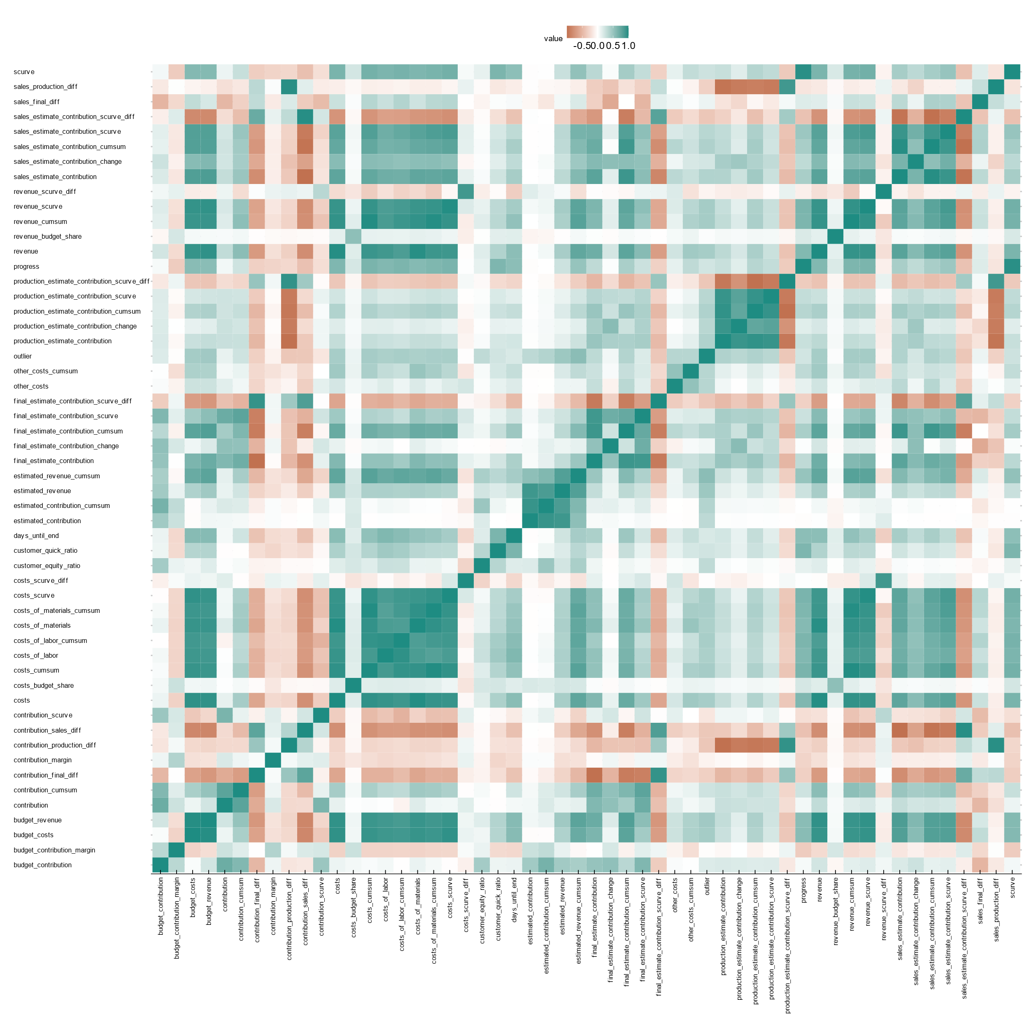

Slide 10
Risk Maturity Model
Ad-hoc
Basal
Defineret
Optimeret
Forbedret
Mange overraskelser
Frustrerende proces
Overfladisk proces
Inkonsekvent anvendelse
Dokumenteret proces
Begrænset prædiktivitet
Basalt informationsgrundlag
Risikostyring som primært værktøj
Skræddersyet informationssæt
En del af alle stadier
Fuldt integreret i projektstyring
Erfaringer er en del af informationssættet
Heuristisk tilgang
Prædiktiv
Ubelønnet risiko
Belønnet risiko

